Slide 1
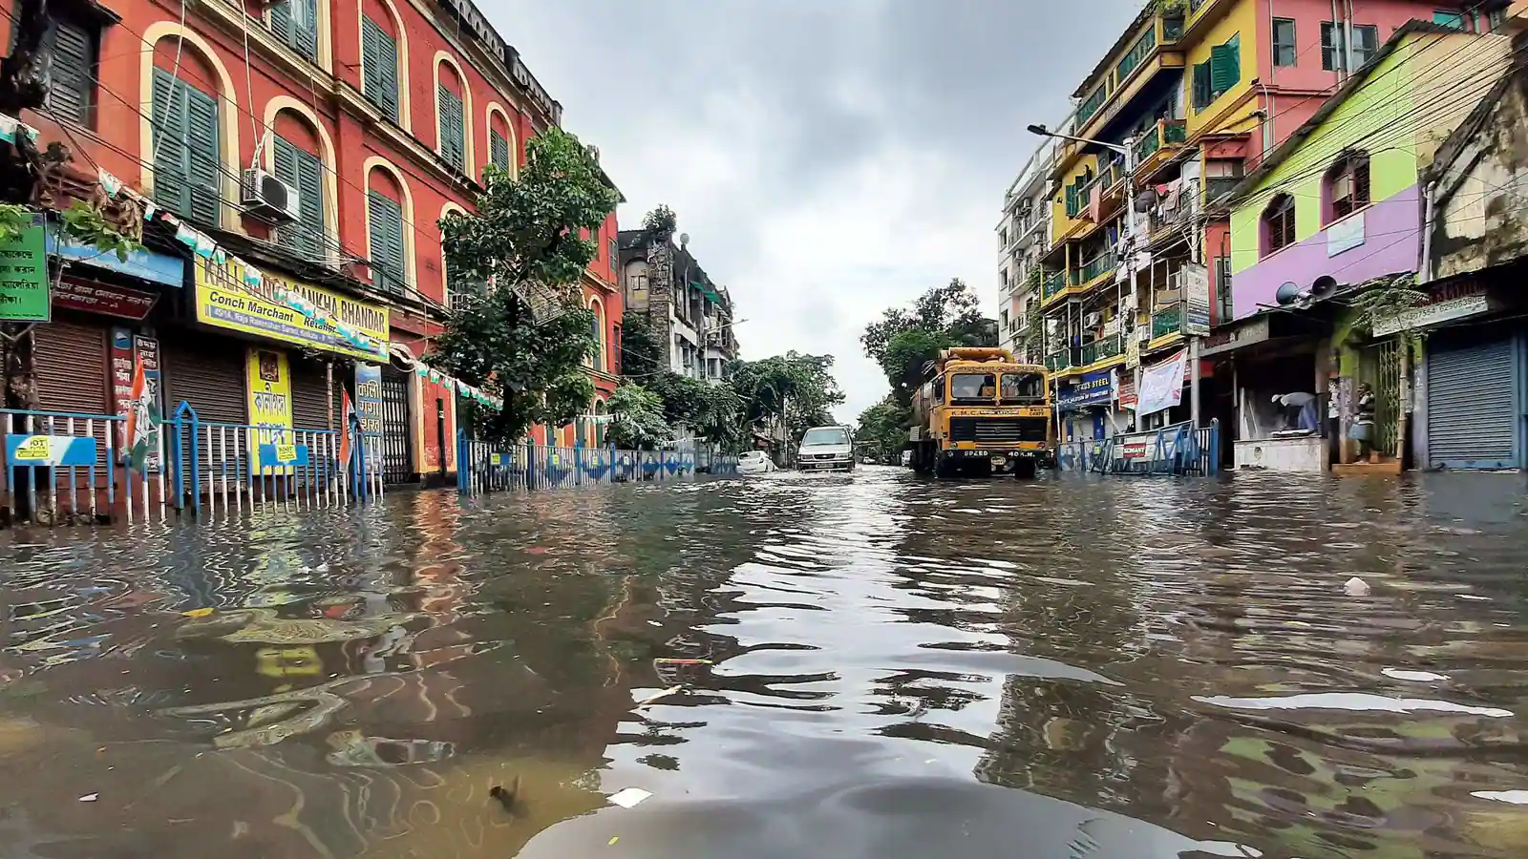
Overview & Impact of Problem
Mega cities like Kolkata struggle majorly with water logging
Heavy/seasonal rain results in water logging
Blockage in sewage pipes are another reason for this problem
Irregular maintenance cause blockage in sewage pipes
Water borne diseases rises
Illness in surrounding families
Increases reduction potential of soil
Changes chemical equilibrium of soil

Slide 2
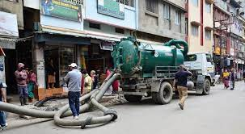
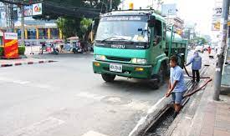
Objective of the solution
Notifying administration about the water logging situation on time
Location of blocked sewage pipe
Unnecessary digging of roads

Slide 3

Overview of solution
Introduction of Smart Water Logging Detection System
Real time water logging information
Pinpoint location of blocked pipe

Slide 4

Methodology of Solution Development
Water Logging
Water Logging Detected
Admin. Notified
Area Location Sent
Blocked Pipe Detected

Slide 5
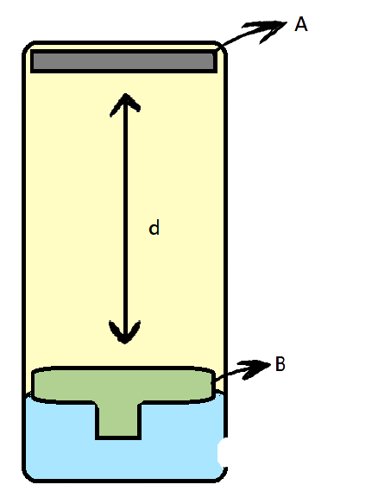
Solution Prototype
Smart Water Logging Detection System:
Water Logging Level Detector (Component I):
A: Level Meter
B: Level Indicator
C: Water Inlet
d: Distance between detector and indicator
C

Slide 6
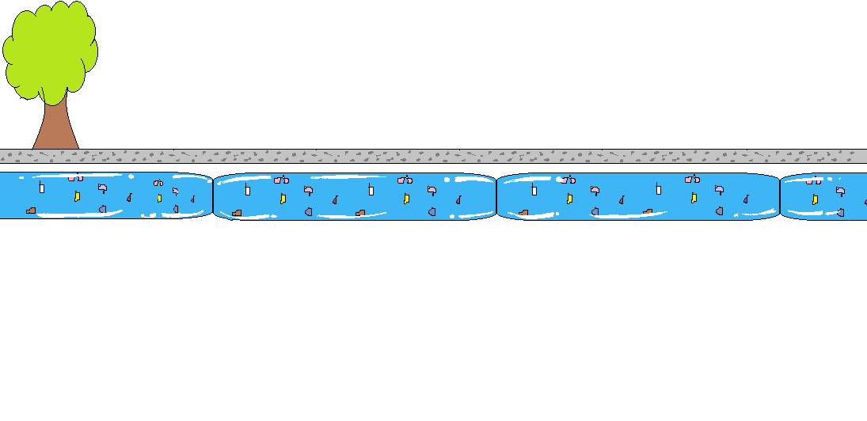
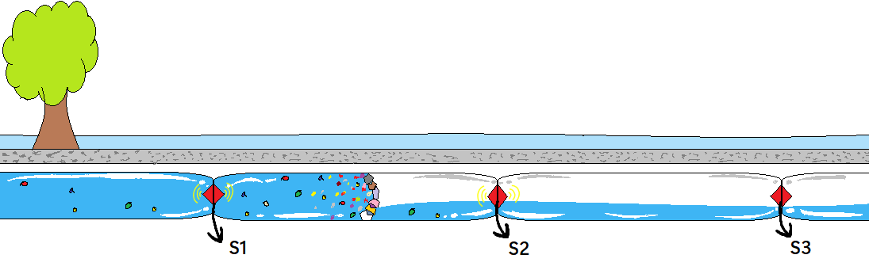
Sewage Blockage Detector (Component II):
S1, S2, S3: Water Pressure/Flow Monitor/Sensors
Before Sewage Blockage
After Sewage Blockage

Slide 7
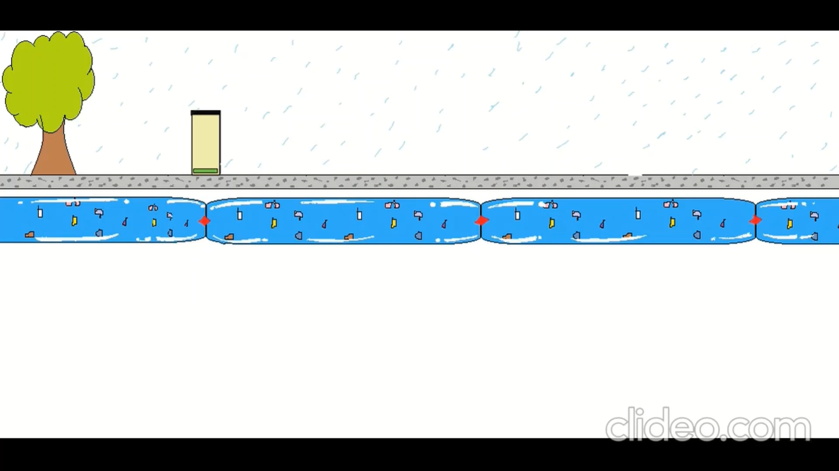
Water Logging Detection System Simulation

Slide 8
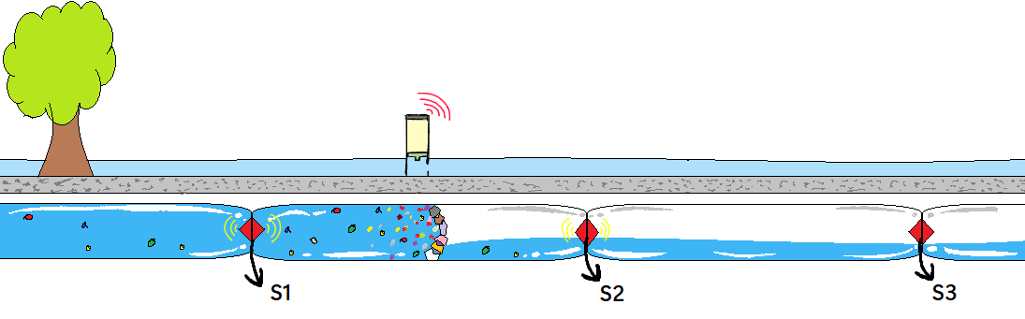
Whole Prototype Visualization

Slide 9
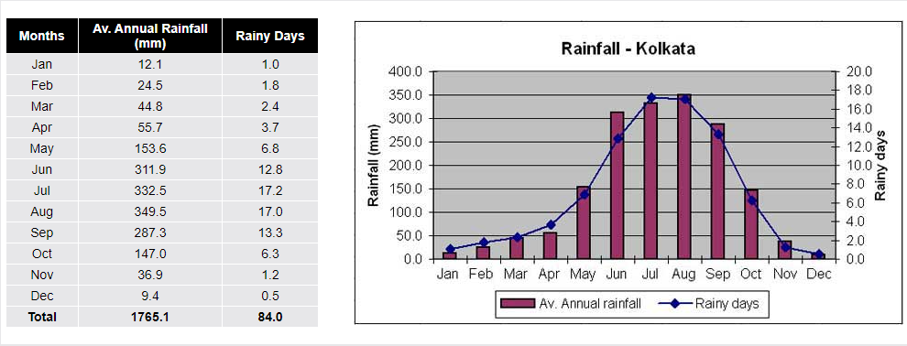
Statistics & Figures

Slide 10
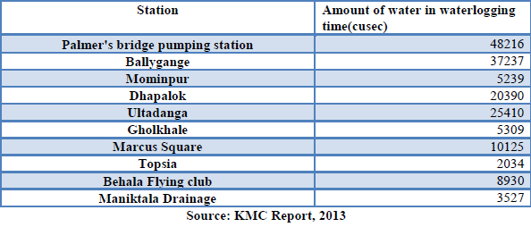
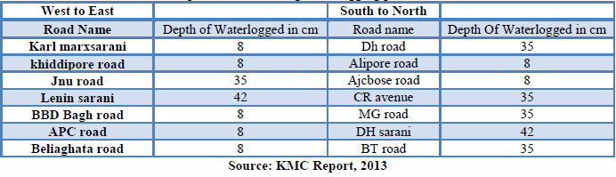

Slide 11
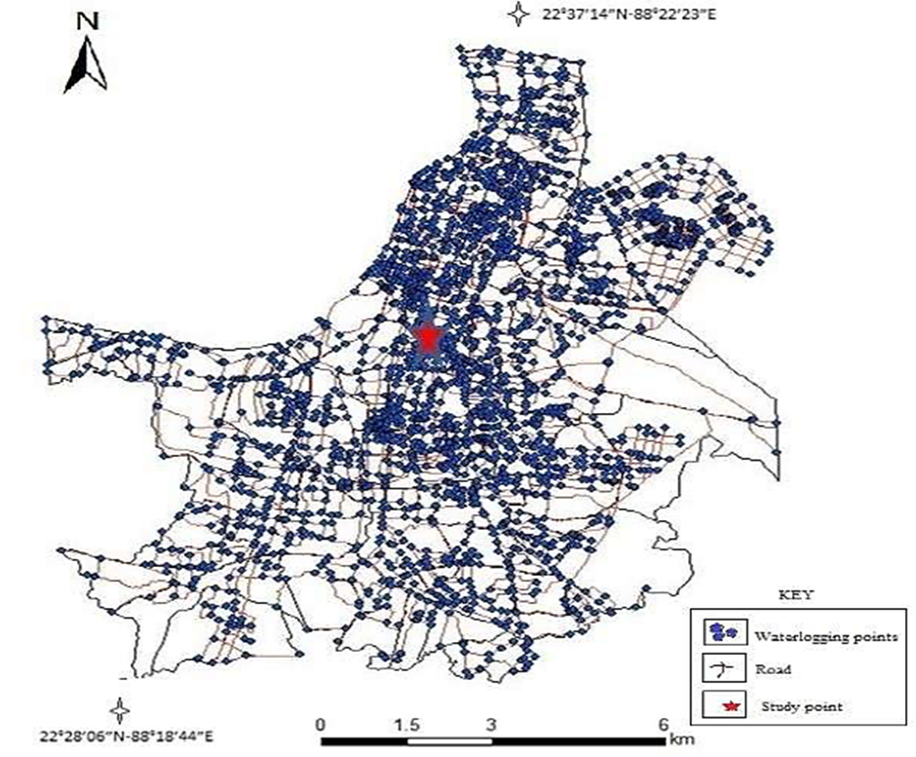
Road nodal point in Kolkata where seasonal (time) water logging observed

Slide 12
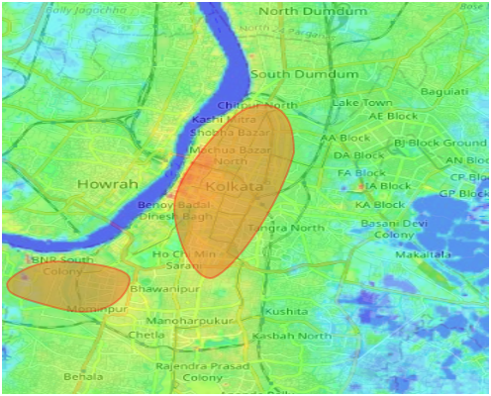
Area where seasonal water logging is maximum

Slide 13
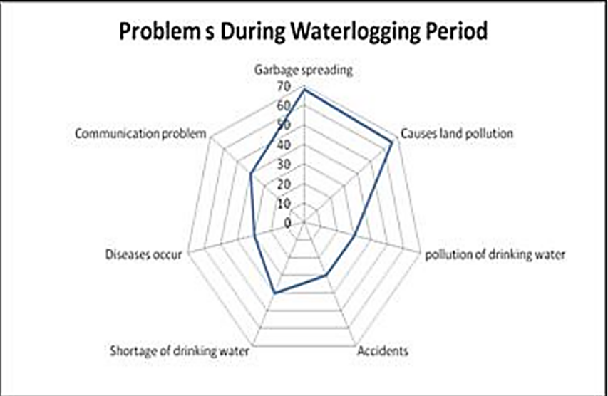

Slide 14
Impact of the Solution
The administration will get real time situation and notification directly on time.
They get information about the level of water logging. It will indicate the severity of the water logging.
The exact location of possible blocked pipe will be informed to the administration.
Water logging can be prevented upto a large scale if proper action is taken.
Unnecessary of digging places can be avoided which distorts the roads and paths that could be dangerous in many ways.

Slide 15

Real time water monitoring in sewage pipes
Real time weather prediction
Real time water logging information
Cost efficient
Internet enabled

Slide 16

Thank You

